Slide 1
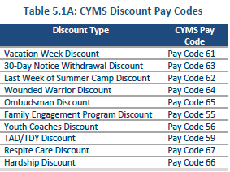
CYP AUTO PAYS (discounts)
Navy CYP uses auto pay codes, usually attached to the customers bill(s) to apply all authorized discounts.
Discount guidance can be found in the current Parent Fee Standard along with the following:
Introduction to CYP chapter 4-5, Family Relations Standards chapter 6 and The CYP E-Library
All discounts MUST be applied using the correct pay code. DO NOT USE GLOBAL CANCEL CHANGE TO APPLY A DISCOUNT TO A HOUSEHOLD.
Table 5.1.A (from the current Parent Fee Standard) below is the current list of all authorized CYP discounts, except for the newly added NAVY CYP Employee discount, which uses pay code 58 and the SAC Hourly Employee Discount which uses pay code 76.

Slide 2
How to calculate a discount
Once you have determined the household eligible for the discount you have to determine the correct amount of the discount.
Use the current CYP Discount Fee Calculator, found on the E-Library to determine the correct discount amount.
There are tabs on the bottom of the CYP Discount Fee Calculator, each tab is labeled with a different type of discount.
Within each tab there is a synopsis about the discount, this provides a better understanding of the discount which can help to answer customer questions.
To calculate the discount, you will need the MPR (military Pay rate) and in the event this is a new customer, the prorated bill. Each child will be calculated separately and will be applied to their individual bill(s).
All discounts are to be attached to the bill before it is processed with the exception of a newly enrolled prorated bill. Use global sales and the discount auto pay code to process for a prorated billed. (shown later in the side deck)
PLEASE NOTE –siblings of registered CDH enrollments and Contractors will be adjusted differently as their bills are NOT considered discounts. (shown later in the side deck)

Slide 3
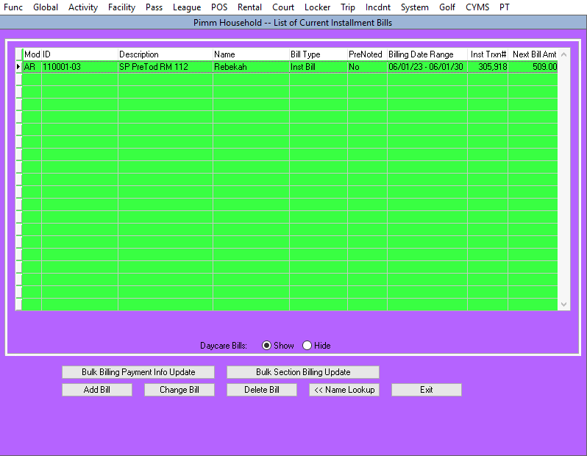
How to attach the auto pay (discount) to the bill
Once you have determined the amount of the discount. You need to attach that discount amount to the bill, before the bill is processed.
From the top task bar or use your hot button. Func- File Maintenance-Global-HH Installment Billing update.
Find Household.
Select the correct child and activity (Blue Arrow)
Select change bill (Yellow Arrow)

Slide 4
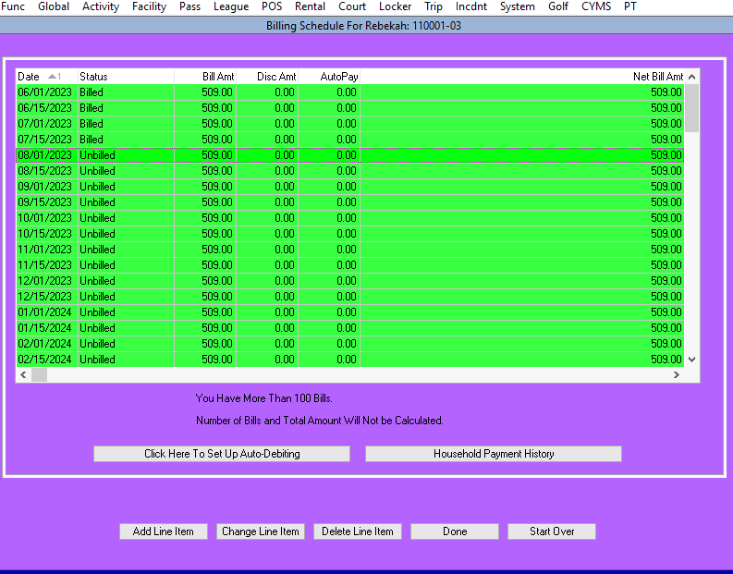
Select the bill date that you want the to apply the discount.
Note a discount cannot be added to a billed line item.
This could also be the date to begin the discount, when the discount is for more than one billing cycle. (Yellow Arrow)
Select change line item. (Blue Arrow)

Slide 5
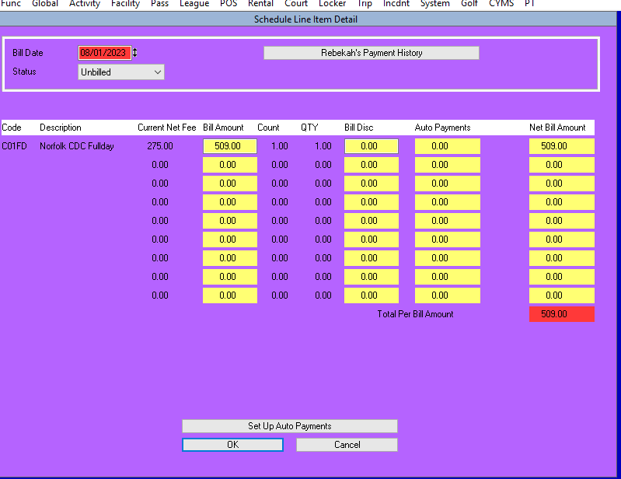
This is the bill screen it shows the current amount of the bill before you add the discount.
Select “set up auto payments”. (Blue Arrow)

Slide 6
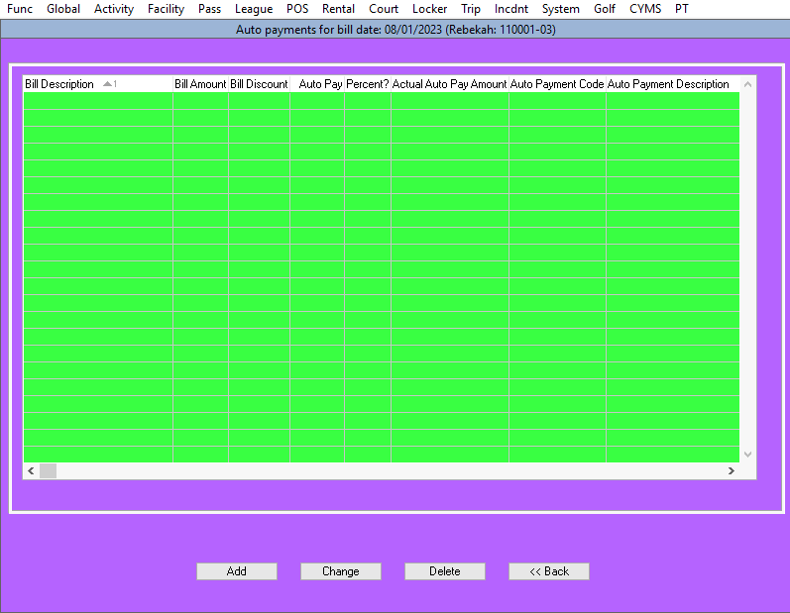
Select the “Add” button to add the discount. (Blue Arrow)
From this screen you can also add another discount in addition to the first. Note the second discount MUST be based on the reduced fee from the 1st discount.
You can also delete the discount if the household no longer qualifies for the discount or decided to not use a vacation discount.

Slide 7
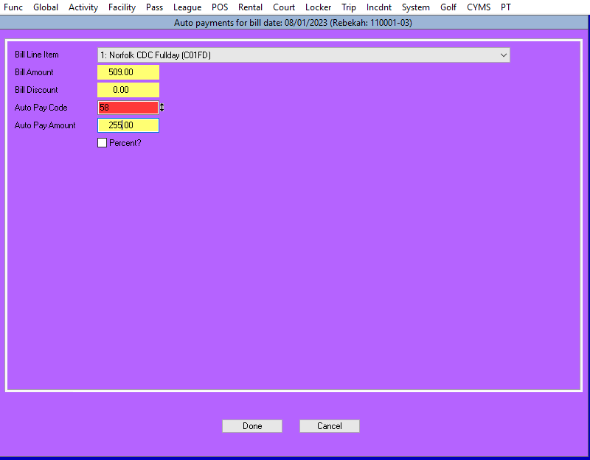
Select Auto Pay Code from pick list, do not type in the code. (Yellow Arrow)
Type in the dollar amount that populated on the CYP Discount Fee calculator. Do not do your own math, use the calculator. (Blue Arrow)
DO NOT USE THE PERCENT RADIO BUTTON!!!! IT IS BROKEN!!!
Select done (Black Button)

Slide 8
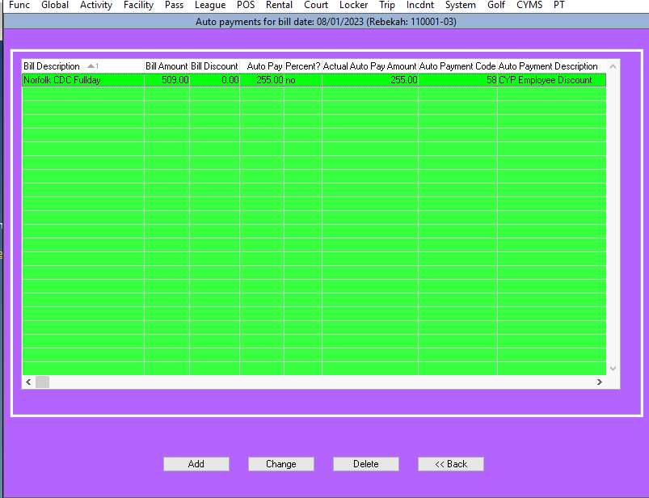
Now you can review the discount
Or Change the discount by selecting the discount and selecting change
Or you can delete the discount if no longer valid.
Or you can add another discount that the household qualifies for.
Once you are happy with the discount(s) select Back (Black Arrow)
Remember with multiple discounts – second discount will be based on the reduced fee from the 1st discount. If further discounts apply, they will be based on the previous reduced fee.

Slide 9
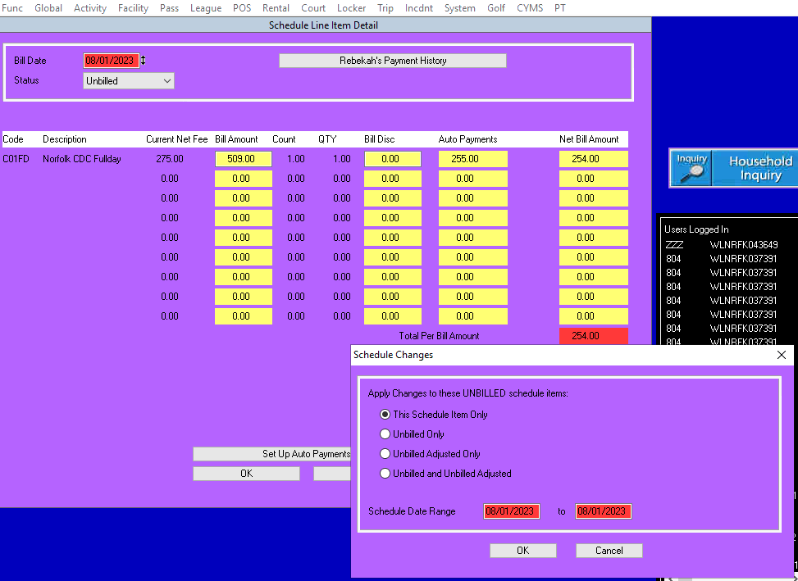
Review the discount again- Notice the discount amount is placed under the auto payments column.
Select OK (Black Arrow)
The “Schedule Changes” screen pops up and you have choices. (Green Arrow)
If the discount is a one-time discount like a vacation, then select “this schedule item only.”
If the discount is authorized for more than one bill, select “Unbilled and Unbilled Adjusted” –the other two options are not needed.

Slide 10
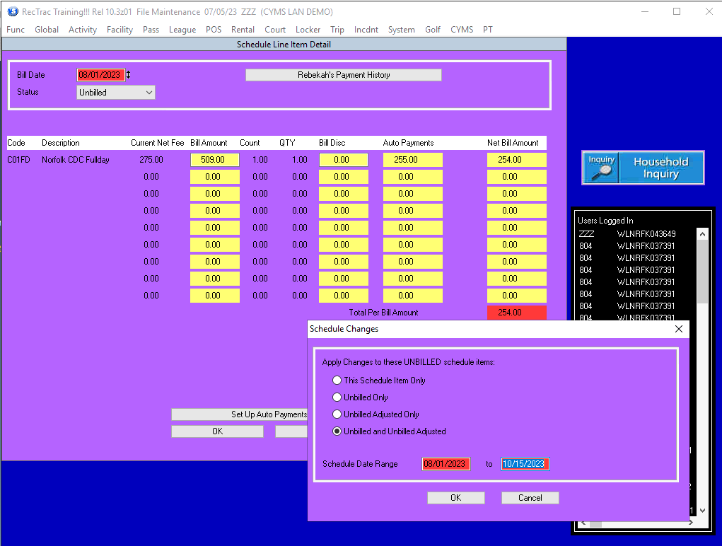
Since this discount is an employee discount we will select “Unbilled and Unbilled Adjusted”. (Black Arrow)
Then we will select a date range.
Remember the billing cycles are the 1st, and the 15th use those dates. Camp bills are individual bills therefore the discount must be placed on each individual bill. The date range will not work. (Green Arrow)
Then select OK (Yellow Arrow)
Remember to end your discounts on Aug 15th as the new fees normally start on Sept 1st and all discounts will need to be updated before running the Sept 1st bill.

Slide 11
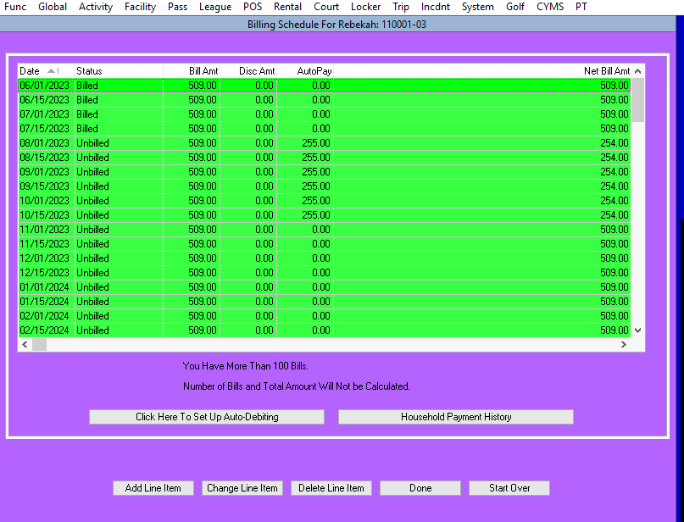
Now you can see that the discount has been applied to all the bills starting with Aug 1- Oct 15th (Yellow Arrow)
The new NET bill amount appears in the far-right column. This is the amount the customer will be billed.
Select done (Black Arrow)
Select Exit or Name look up if you are processing a discount for another household.

Slide 12
How to attach the discount to a prorated bill
First enroll the child into the activity.
Note the amount of the prorate bill at enrollment.
If you need to double check the prorated amount, do a quick review under household inquiry.
Once you have determined the bill amount and the customers eligibility for the discount you will need to determine the discount amount.
Note vacation discounts require a two week notice and should not be used to postpone an enrollment date. (exceptions do apply)
Use the CYP Discount Fee Calculator to determine the correct discount amount.
Then go to global sales and make a payment in the household using the correct auto pay code.
Remember the household must owe at least the amount of the discount, discounts cannot create a household credit.

Slide 13
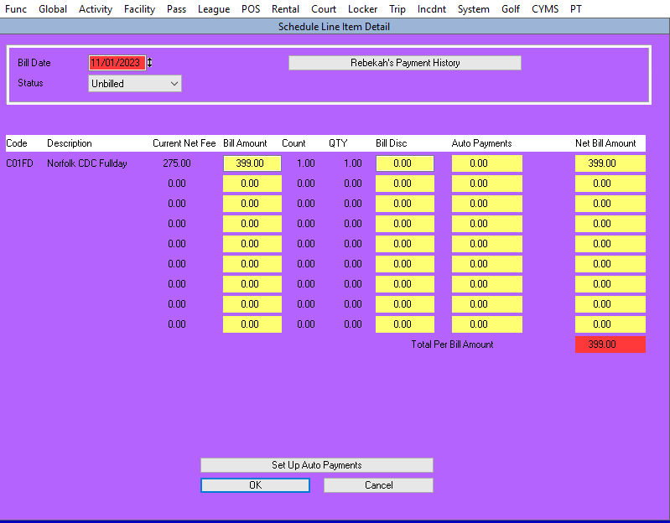
How to change bills for Contractors and CDH enrollments
Contractors and siblings enrolled in CDH will need to have their bills adjusted before billing is processed.
First confirm the customer's bill amount.
Contractor fees are a fixed amount without second child discounts. Amount of those bills will be found on the current fee chart.
CDH – you may want to work with your regional CDH director to determine the correct fee. Their fees will be based on current TFI and first or second child.
Once you have the correct fee amount, follow the steps on slides 14-15.

Slide 14
Once you are on this screen, you simply highlight and change the dollar amount in the column labeled bill amount. (Black Arrow)
In this case the dollar amount of 399 will be change to 470 (CONSA category). Remember to review your current fees as this amount is just an example.

Slide 15
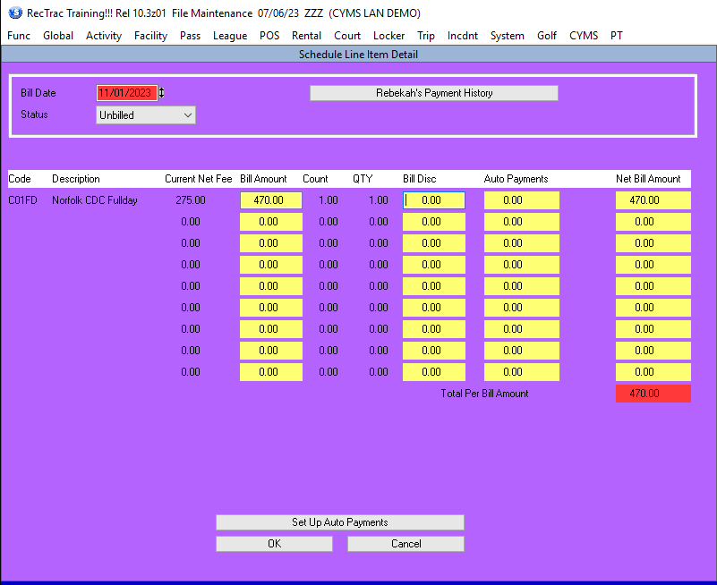
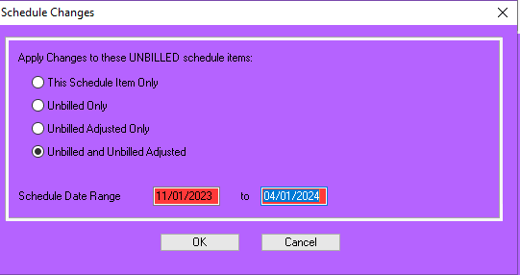
Notice the bill amount and the Net Bill Amount column have been adjusted.
Next select Ok (Black Arrow)
The “Schedule Changes” screen pops up and you have choices.
In this case the change is for more than one bill so select “Unbilled and Unbilled Adjusted”
Then select a date range.
Once you have the date range
Select OK (Yellow Arrow)

Slide 16
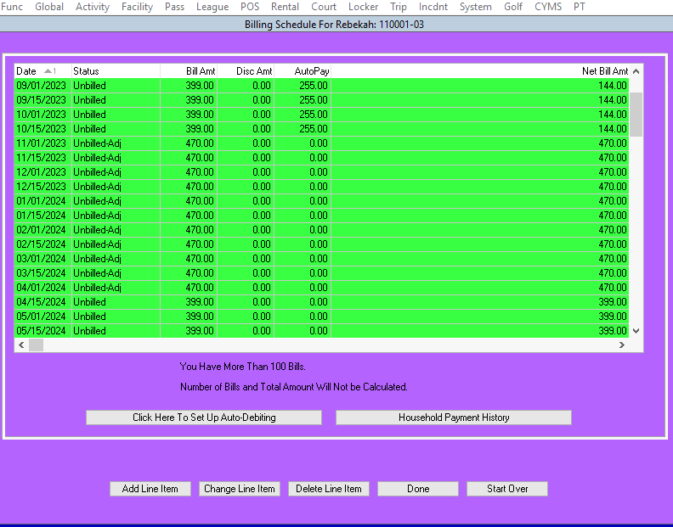
Notice the bills from 11/01/2023 through 4/1/2023 have been adjusted to the new fee of 470.00 and are now labeled unbilled-adjusted. (Yellow Arrows)
Net bill amount is the amount the customer will be billed and has also been adjusted. (Black Arrow)
From here you should select done.

Slide 17
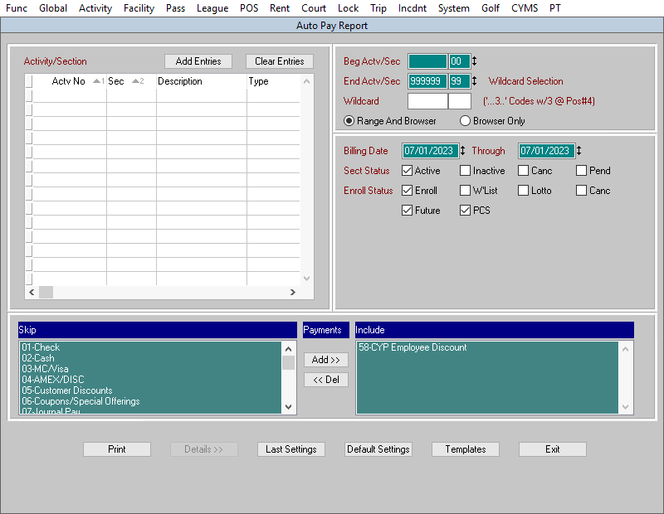
From the top task bar
Select Func-Report-CYMS-Admin Reports-Auto Pay Reports. Some Regions only allow Managers to run this report
1-Your screen should include all activities. (Blue Arrow)
2-Select the bill date or dates you want to look at. (Red Arrow)
3-Include active, enrolled, future and PCS types of enrollments. (Black Arrow)
4-Add types of discounts you want to include, use the add and del (delete) buttons. (Yellow Arrow)
You can run this report whenever you want, before or after the billing. Best practice- run a day or two before each billing is processed.
How to run an auto pay report

Slide 18
Any Questions?

